Slide 1
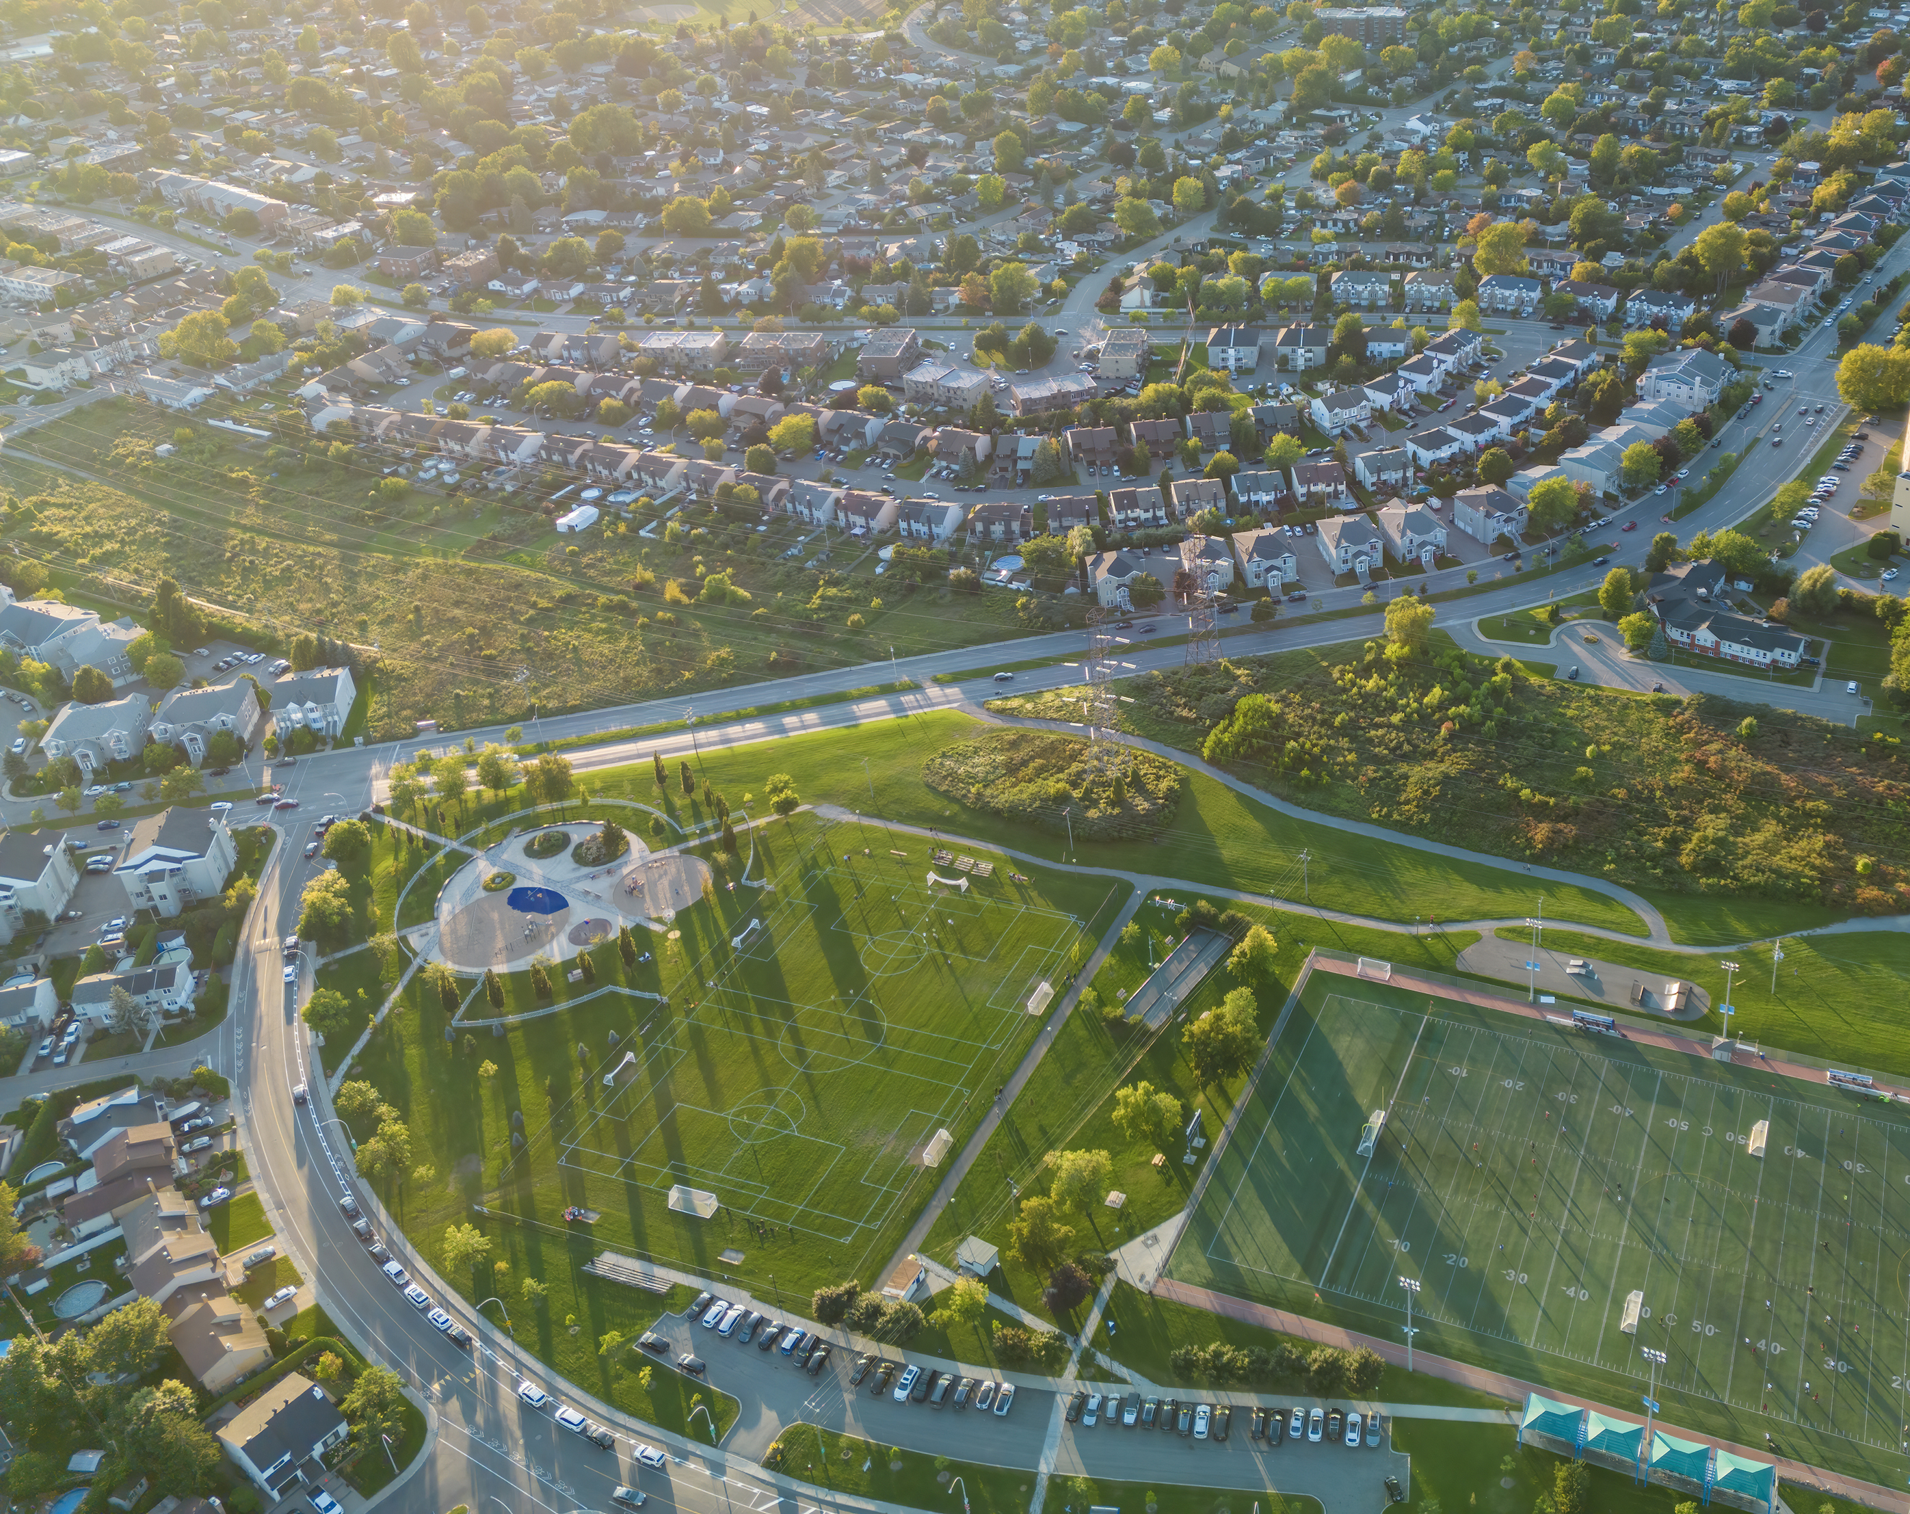
Introduction of Garrett Road Modernization Multimodal Project
Public Works Department
June 18, 2025

Slide 2
Background
Garrett Road is a major arterial road within Upper Darby Township
High traffic volume – Vehicles and Public Transportation
High pedestrian activity – Two Schools, seven trolley stations, 69th Street terminal and several commercial businesses
Redevelopment of the Bonner-Prendergast site as the new Delaware County College facility
Partnership between PennDOT District 6-0, Delaware Valley Regional Planning Commission (DVRPC), and Upper Darby Township

Slide 3
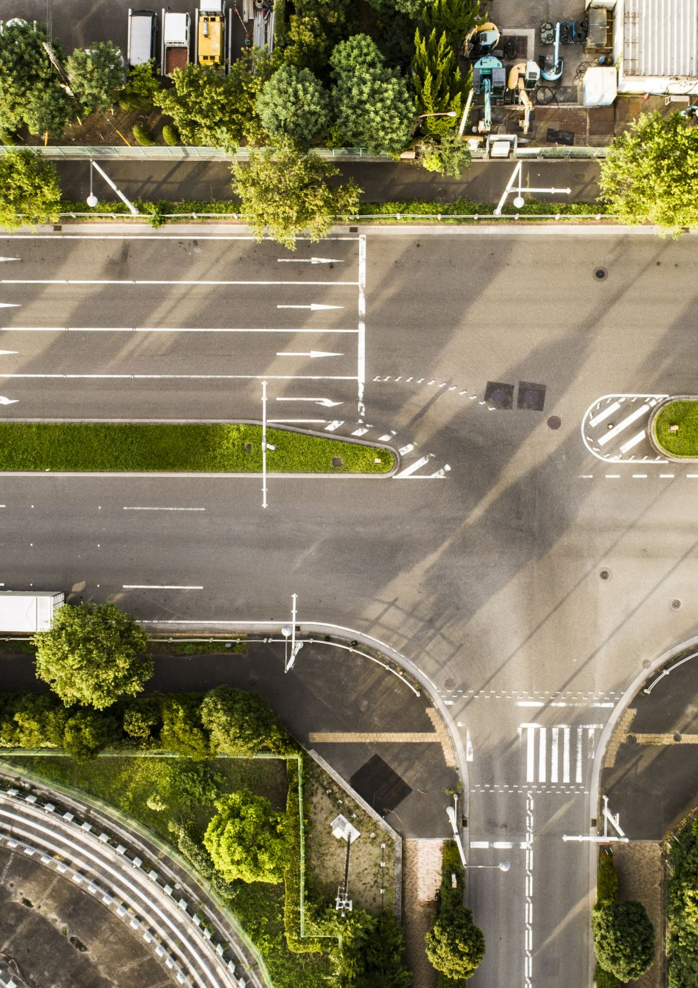
Analysis
This project involves site improvements along Garrett Road from Lansdowne Avenue to Sherbrook Blvd.
  Support safety improvements, accessibility enhancements, and traffic signal optimization
  Enhanced access and safety to Naylors Run park

Slide 4
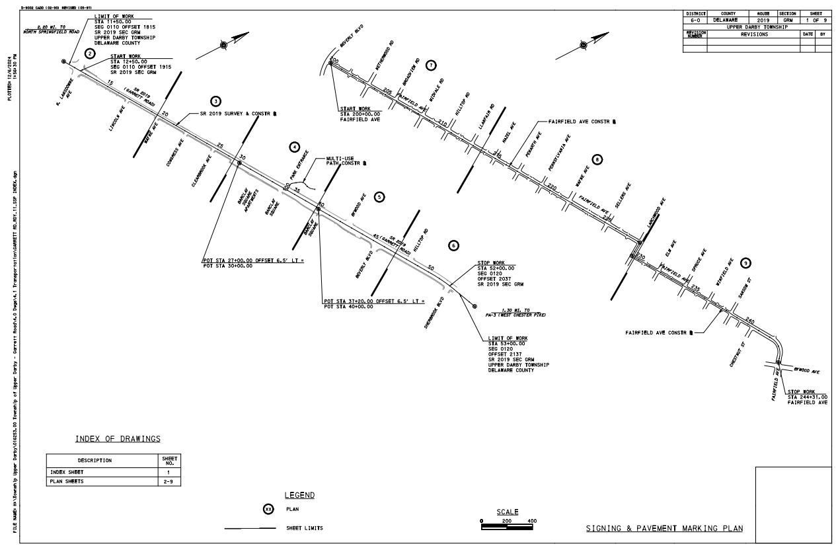
Overall Scope of Work

Slide 5
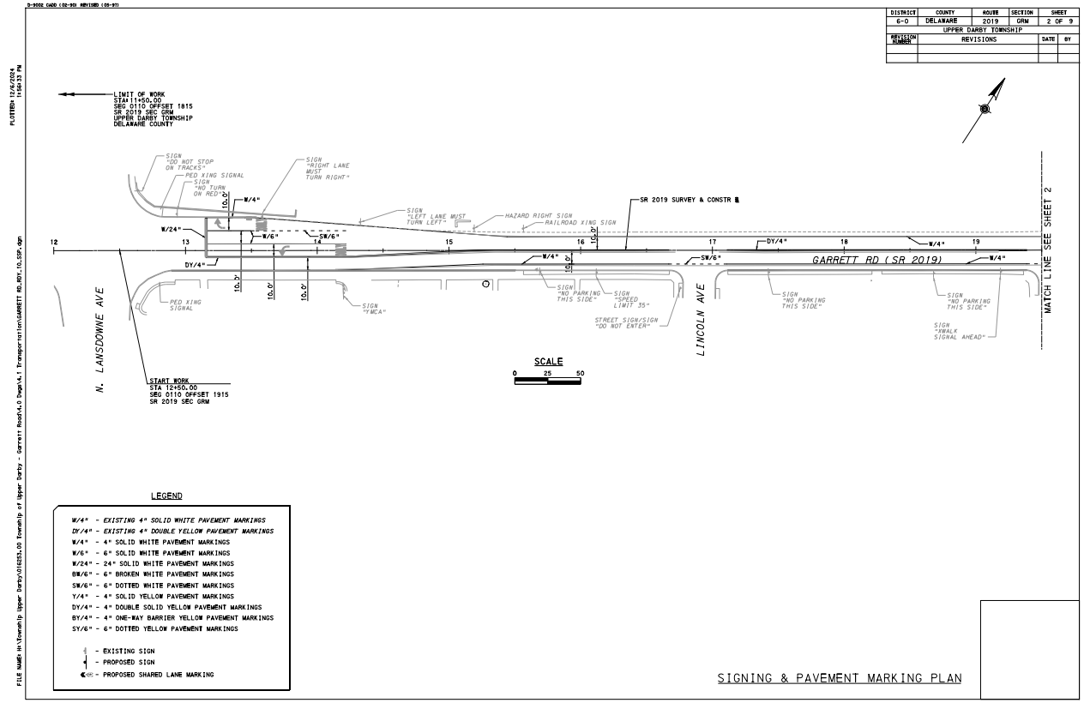
New pavement marking at the start of the work on
N. Lansdowne Ave.

Slide 6
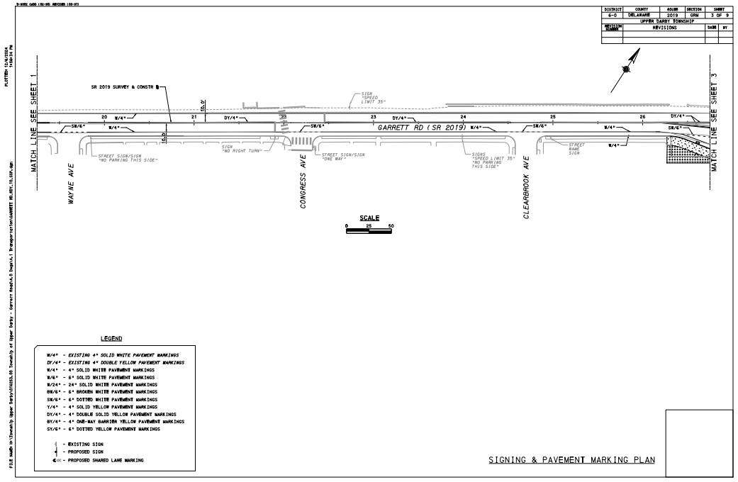
Widening of sidewalk and addition of landscape area

Slide 7
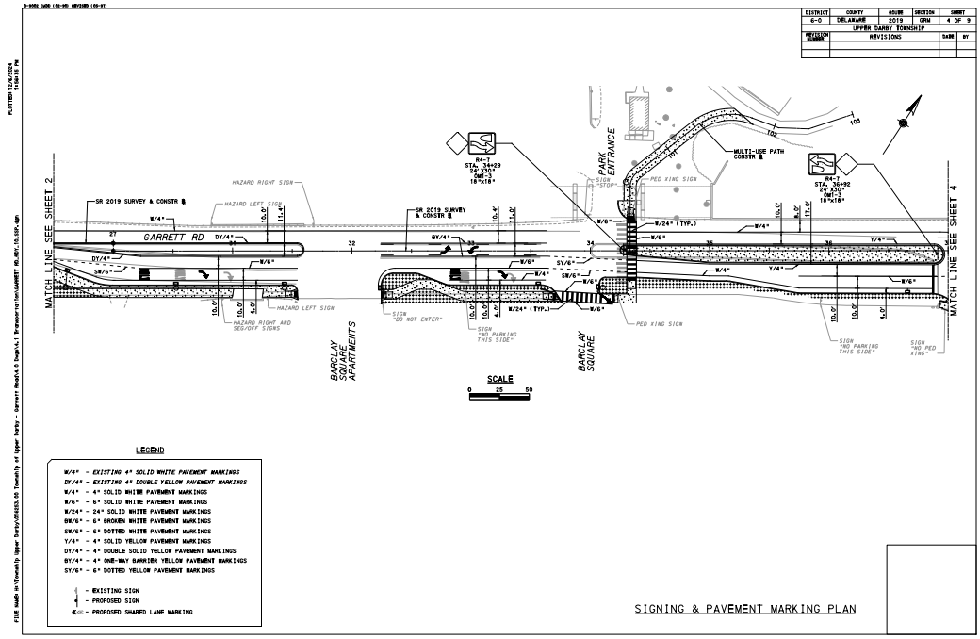
Widening of sidewalk, addition of continental crossings, construction of a new median, and addition of landscape areas.
Construction of new sidewalk to the Naylors Run park.

Slide 8
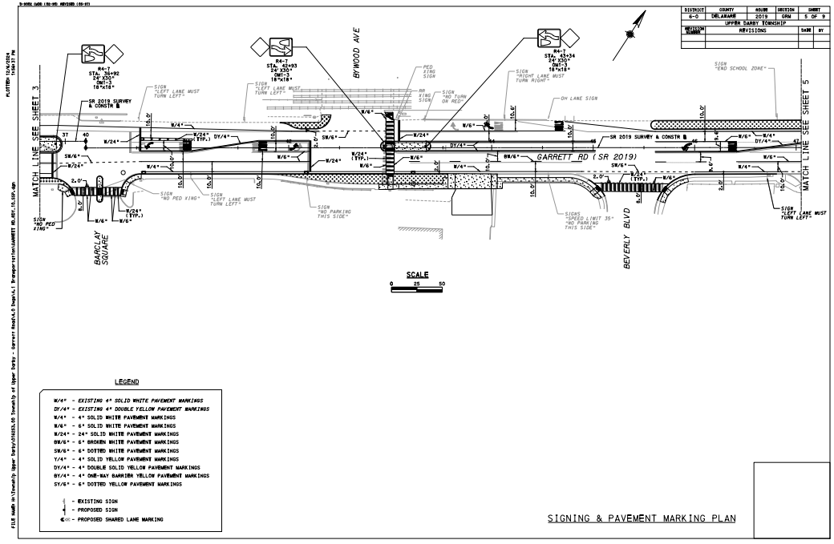
Reconstruction of sidewalks for ADA accessibility, addition of continental crossings, and addition of landscape areas

Slide 9
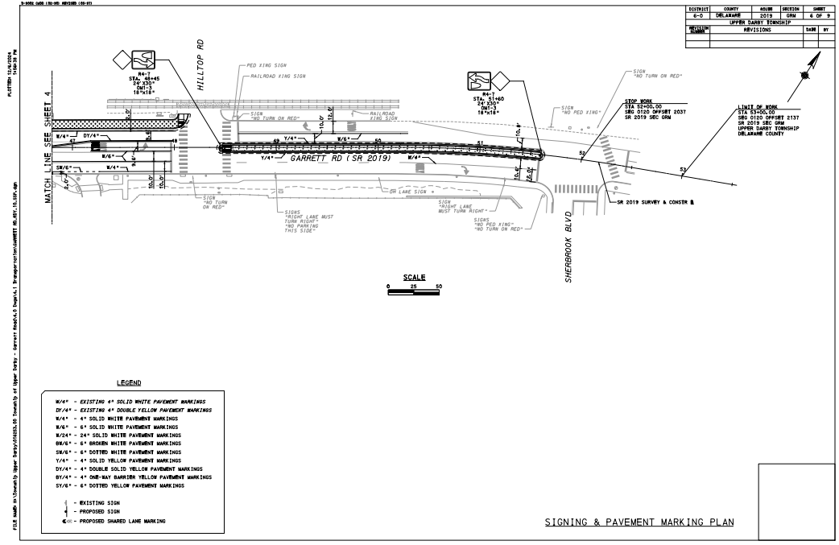
Reconstruction of the sidewalk for ADA accessibility and construction of a new median for pedestrian refuge

Slide 10
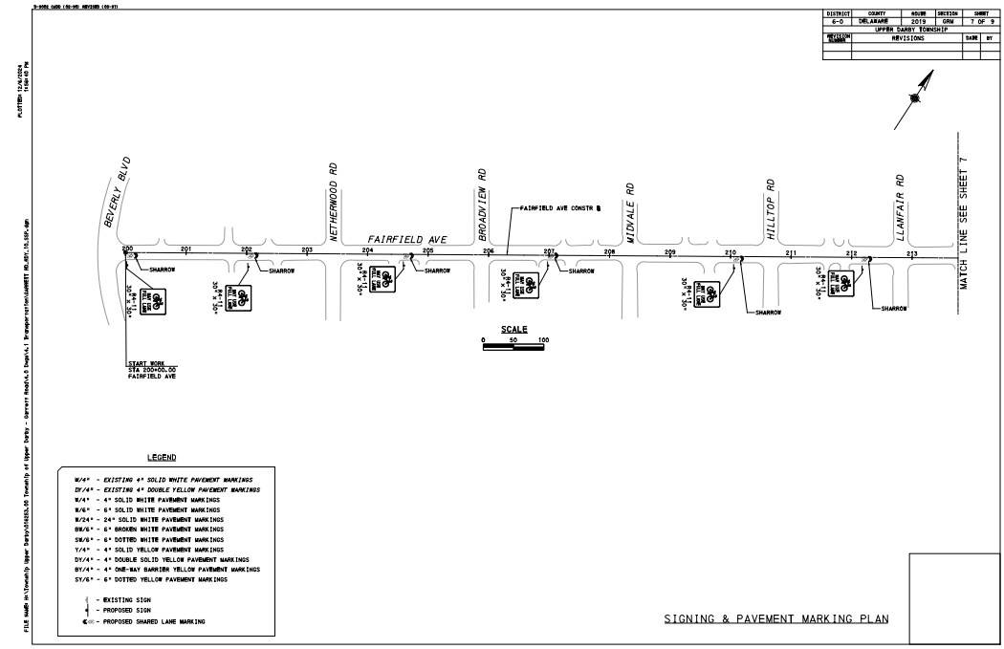
Proposed installation of sharrows from Beverly Blvd.

Slide 11
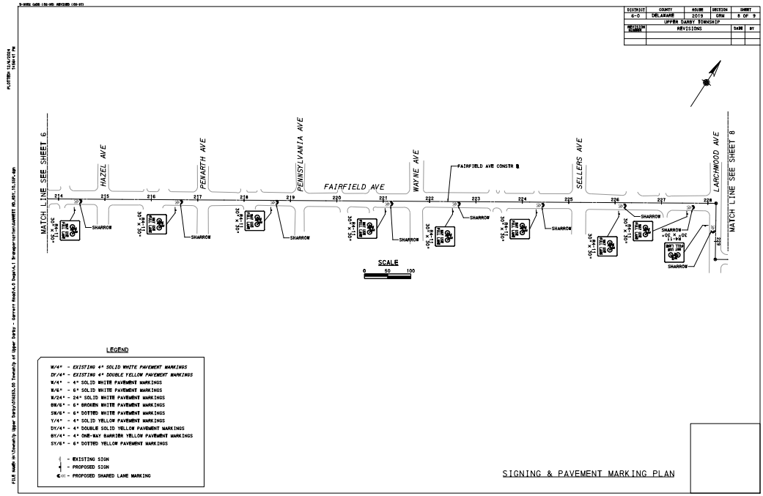

Slide 12
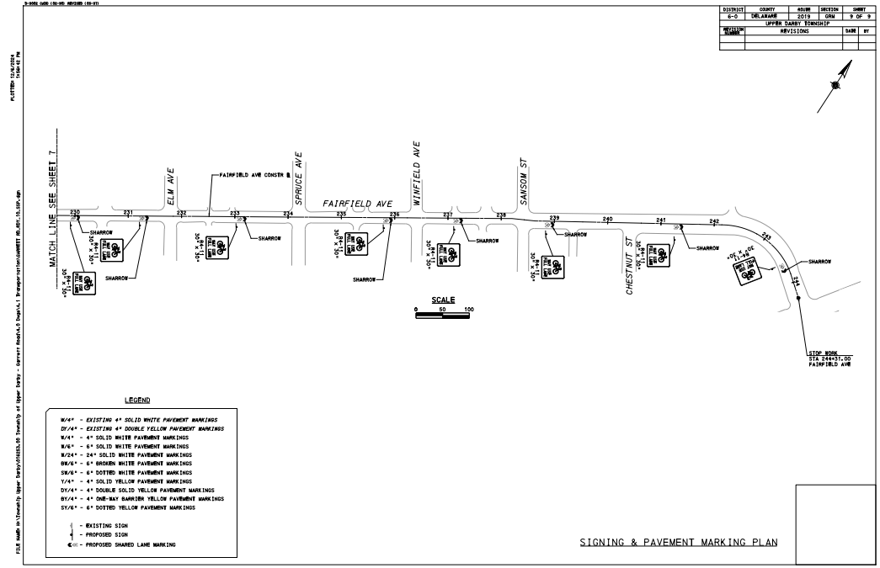
Proposed installation of sharrows to Bywood Ave.

Slide 13
Fiscal Impact
The project received a Multimodal Transportation Fund (MTF) grant to fund the construction phase
  Transportation Alternatives Set-Aside Program under MPMS 118358 for 1.3M
Township funds are being used for the design

Slide 14
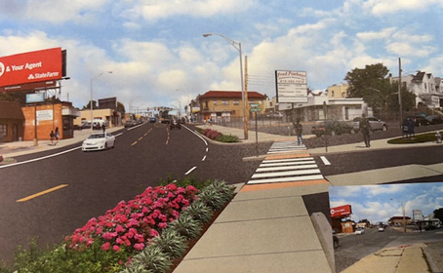
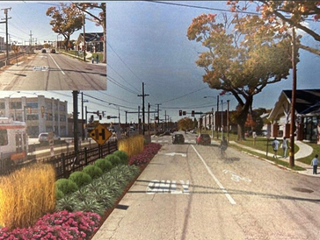
Timeline
Design for this project is at 60% completion
Plan to complete design by end of 2025
As part of the MTF Grant Funding requirement, staff are introducing this project to Council for their information
Township will work closely with PennDOT to formulate a timeline for construction phase

Slide 15


